Slide 1



Computing Services Committee Survey Results
Under the Guidance of:
Prof Bei Yu
Jeff Hemsley
By:
Trishla Jain, Karthik Ramanathan
IST 736 Project

Slide 2
About
The University Faculty Senate's Computing Services Committee asked faculty and staff to respond to an online survey about campus computing services and technology.
The survey ran from the end of September to midway through October.
The response rate was nearly 30% of those we sent it out too.
Most of the questions are Likert Scale questions (multiple choice agree to disagree), but we did include a number or free text boxes.

Slide 3
Technologies Feedback List
Wireless Network
MySlice
Zoom
Teams
Blackboard
Kaltura
Teaching Tools
Assistive Tools
Accessibility Feedback
IT Challenges
Security
Playposit
Google Suite

Slide 4

Wireless Network
User Satisfaction: 65%
Clustering showed following areas of improvement:
Login
Improve connectivity in certain campus regions

Slide 5
Causes of Dissatisfaction
Their ability and my ability to access the wifi is crucial to the learning process. I have had issues in the past, but I have a class in life sciences this semester, and I have had to print out my google doc prompts every class because I cannot count on the wifi.
"I ride the bus to/from the Manley parking lot and College Place every day. AirOrangeX doesn't work on the bus. Even when sitting on the bus at College Place, it often doesn't connect - let alone on the bus ride down Comstock."
"It kicks my phone off A LOT and constantly asks me to reauthenticate. When I do, it says 'bad password' and I'm 100% sure my password is fine. Kinda frustrating."
'sometimes problematic to connect'
Bandwidth
Login

Slide 6

MySlice (Recap)
User Satisfaction : 73%
Clustering showed following areas of improvement:
Better navigation
Improve interface
Avoid stale user login issue
Ability to set faculty interface as default
Better communication of changes

Slide 7
Causes of Dissatisfaction
“Extremely not user friendly system, no information for new employees on how to use it”
“Not user friendly and I keep getting kicked out.”
'Bizarre format changes recently, very hard to find things'
"The tile interface is completely confusing - I don't know where to find anything that I'm looking for"
“Going back and forth between pages has never been easy or intuitive though this has improved over the years”
“Some of the items are difficult to find.”
Not User Friendly
Site Layout
Site Layout
7.7% users extremely unhappy
12% users unhappy
11% users somewhat unhappy

Slide 8
Feedback Sentiment Classification
BertClassifier – Accuracy – 30.21%
Word2Vec – Accuracy – 34.46%
RoBERTa – Accuracy – 55.21%

Slide 9
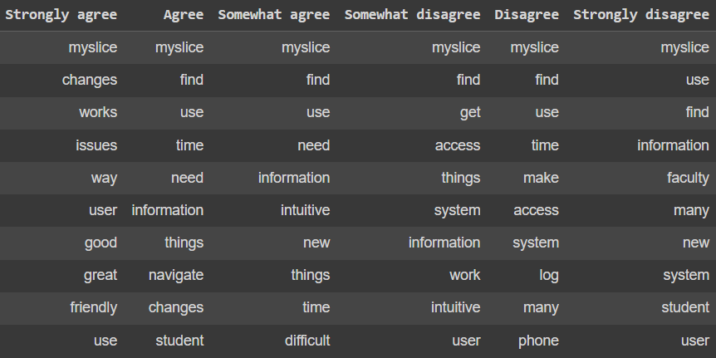
Error Analysis
76 feedback statements classified incorrectly
95% being mis-classified as ‘Somewhat Agree’ which is acting as the model’s default category.
Strongly Agree : 4
Agree : 31
Somewhat Agree : 2
Somewhat Disagree : 10
Disagree : 12
Strongly Disagree : 8

Slide 10

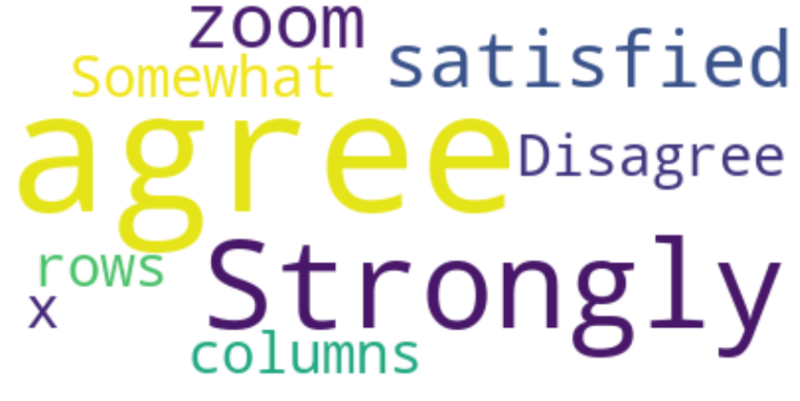
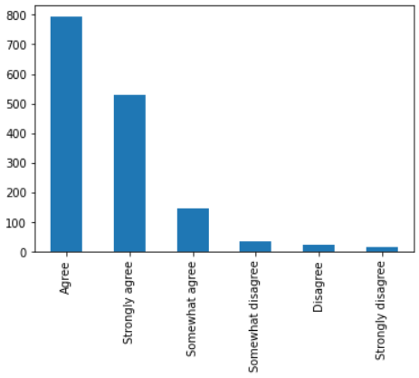
Zoom
User Satisfaction : 95.22%
Very high user satisfaction resulted in small count of user dissatisfaction text

Slide 11

Teams
User Satisfaction: 80.5%
Picture Quality - major factor of dissatisfaction
Zoom is the preferred product as 19.5% users are dissatisfied with Teams whereas only 4.8% were dissatisfied with Zoom.
Clustering showed following areas of improvement:
Chat interface, screen layouts & Mic
Prefer Zoom

Slide 12
Causes of Dissatisfaction
'I prefer Zoom'
'More comfortable with Zoom'
'Teams is not good for chatting compared to Zoom, Discord, Slack, Element (Matrix). '
'The mic stops functioning in the meeting. It is random and presents a problem for me as I do several presentations.'
Interface
Preference

Slide 13
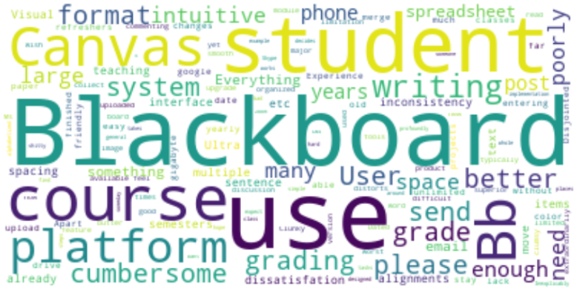
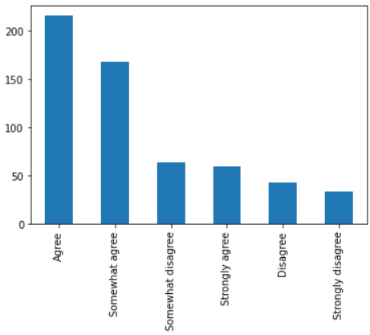
Blackboard
User Satisfaction : 76%
However, there are only 17 review text which doesn’t give any concrete insight into the issues faced by the users

Slide 14

Kaltura
User Satisfaction : 93.5%
However, there is only 1 review text which doesn’t give any concrete insight into the issues faced by the users

Slide 15

Teaching Tools
Found Information easily: 83%
Happy with Support: 85.8%
Happy with Communication: 79.8%
Blackboard, Kaltura and Playposit require improvement.
Clustering showed following areas of improvement:
Unhappy with Blackboard would prefer Canva
Productivity impact

Slide 16
Causes of Dissatisfaction
'I can't for the life of me understand why we're not using Canvas or some other alternative, which are infinitely better and used by our peer institutions; and why we've apparently even extended our contract with Blackboard.'
'The only reason I feel somewhat comfortable using blackboard is because of the ITS intensive SITL workshop’
‘Sign on to the "system" with my credentials every single time I want to use Adobe in a classroom computer to show my slides...really? ’
‘Sometimes I accidentally learn from colleagues or someone from IT about certain tools that exist for faculty but we never were informed of them and never had workshops’
Blackboard
Login & Awareness

Slide 17

Assistive Tools
Use Assistive Tools: 96.8% don’t use
No sentiment and text feedback column
Out of the assistive tools, seems like Windows for MAC and JAWS for Windows are used the most.

Slide 18

Accessibility Feedback
Measured through 4 metrics:
Policy Knowledge: User Satisfaction = 78.4%
Doc creation impact: User Satisfaction = 64%
Aware toolkit: User Satisfaction = 58%
Professional development: User Satisfaction = 72%
Frequency analysis shows that difficulty in finding the right information and the search feature are a source of discomfort

Slide 19
Causes of Dissatisfaction
“Search functions are not always productive; you almost have to know exactly what you're looking”
“Search function through the website is not always very helpful and accurate”
“the organization of the links is difficult to follow and there is resistance in assisting us with a major overhaul”
"Information is hard to find, and there are very few pictures."
“It's difficult to find information because it's fragmented and not easy to find”
“I find when there is a reorganization it is hard to find where the info is.”
Search Feature
Site Layout
Difficulty finding info

Slide 20
Causes of Dissatisfaction
“There are definite holes in the accessibility policy relating to software that does not go through a procurement life cycle.”
“Current accessibility guidelines seem to we make our life harder than what it needs to be”
Issues with Accessibility Policy

Slide 21

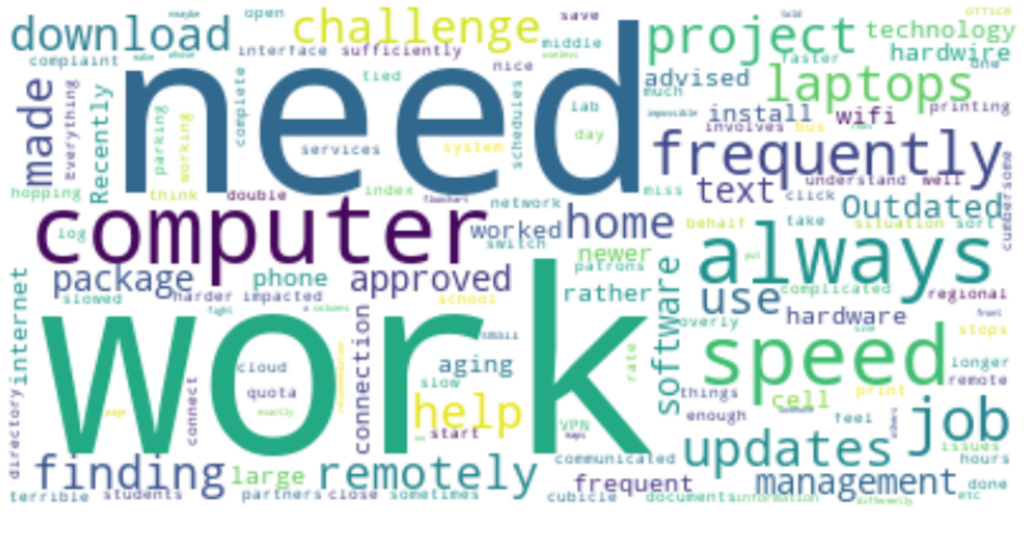
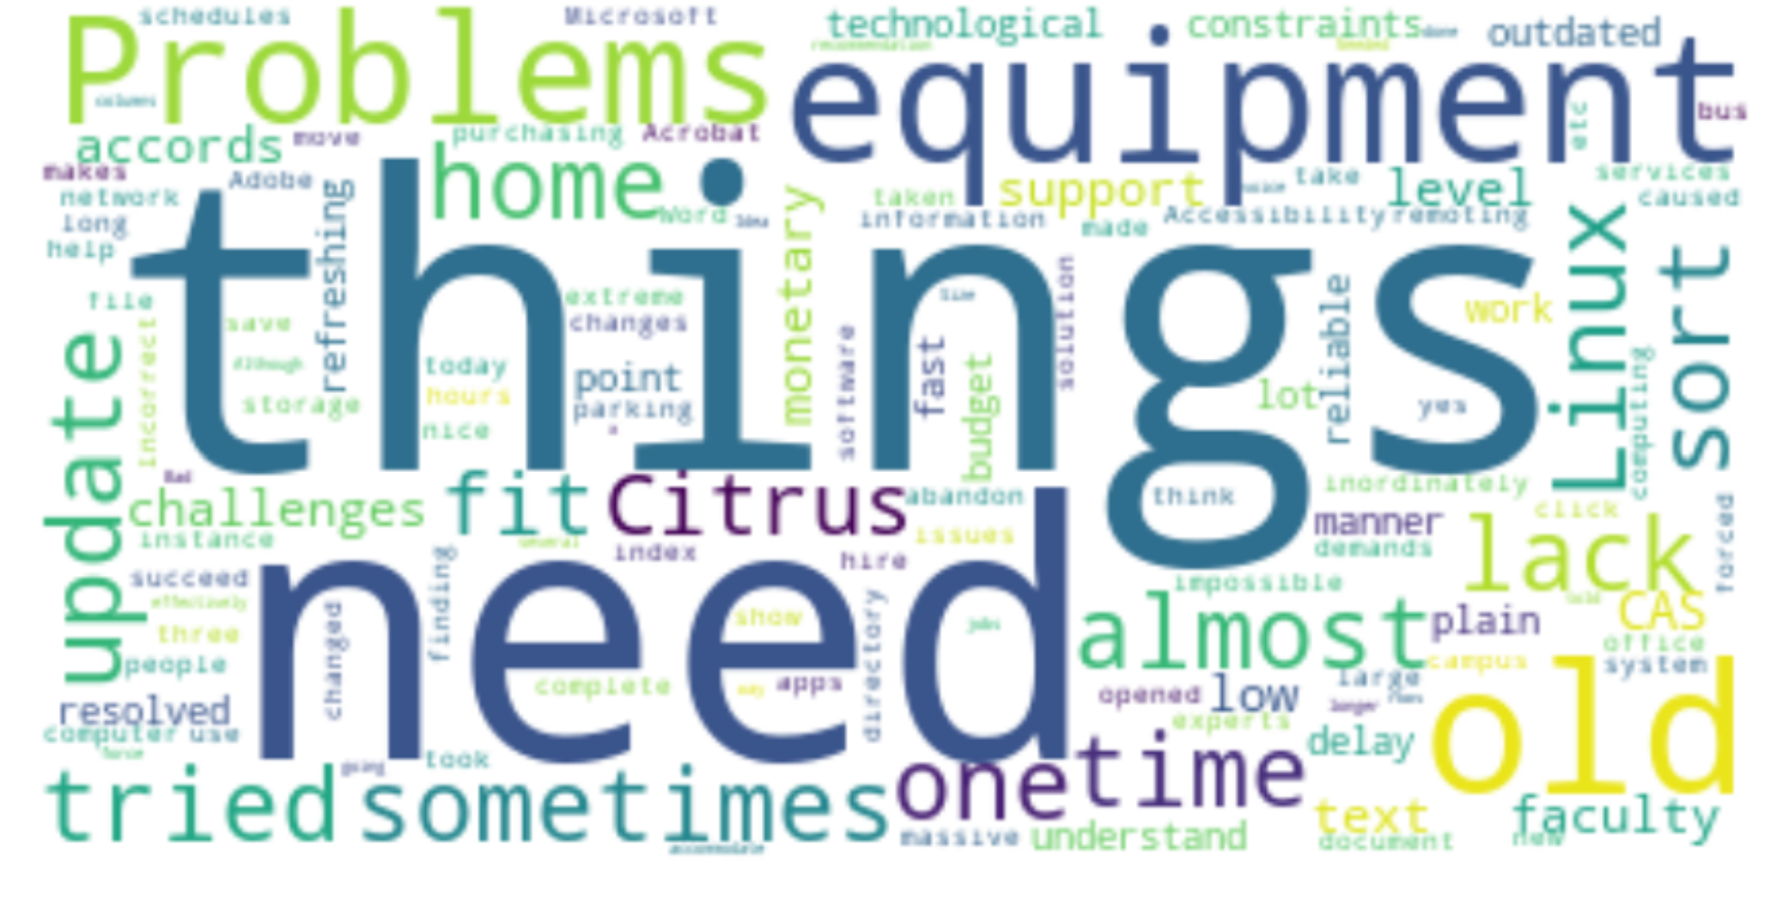
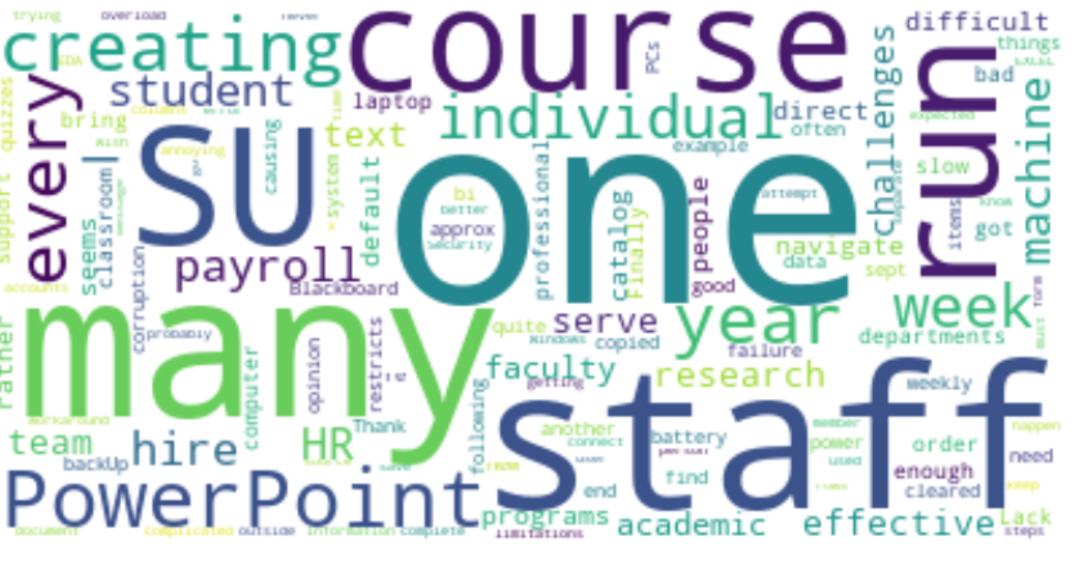
IT Challenges

Slide 22
Common reasons for dissatisfaction
Blackboard
Myslice
Access
Software

Slide 23
Causes of Dissatisfaction
‘Add more staff to your team or pay them more money’
'ITS, along with most schools/departments are having a very hard time hiring exceptional candidates. Many of the candidates are requesting much more for salary than we can provide.’
'It is impossible to find information in answers. you need to know exactly "answer" you\'re looking for, but I only ever have questions, so this tool is rarely helpful in a time effective manner. I always have to dig.'
'Answers never finds the answers to my questions', 'answers pages'
Answers.com
Support

Slide 24
Causes of Dissatisfaction
'Using Blackboard. I recommend replacing it with easier to use software’
'making documents more accessible on blackboard'
'Outdated technology like laptops and cell phone; need more frequent updates and newer hardware'
'I have an aging laptop that needs frequent service, response to ACS tickets have been inconsistently helpful'
Hardware
Blackboard

Slide 25

Security
77.65% agree that Security has Min impact on their work
86.19% users agree wrt Effective communication
85.34% users know who to talk to wrt security
65.29% take the yearly training
Training wrt security is necessary and multifactor authentication is an issue if phone isn’t working.

Slide 26

Playposit
88.09% users are happy with the software
Only one text feedback - Clunky

Slide 27

Google Suite
96.15% users are happy with the software
Only 2 responses so couldn’t run Topic Modeling

Slide 28
Conclusion?

Slide 29

Thank You Questions?

